Slide 1
INSTITUTIONAL STUDENT PROGRAMS AND SERVICES (ISPS) Scholarship and Accommodation Services
Prof. Milagros B. Barruga
Chief, Institutional Student Programs and Services
Office of the Student Affairs and Services

Slide 2
ISPS Services (CMO 9, 2013)
Admission (Admission Office)
Scholarship and Financial Assistance
Food (Business Directorate)
Health (Infirmary)
Security and Safety (Security and Monitoring Services)
Housing and Residential Services
Multi-Faith (Student Welfare)
Foreign/International Students (External Linkages)
Services for special needs and other programs such as: culture and arts, sports, social and community involvement. (Student Development, CHUMS, Extension Directorate)

Slide 3
In this presentation
1. Scholarship Services
SUC-CGMS – Cash Grant to Medical Students enrolled in State Universities and Colleges
DOH Pre-Service Scholarship Program
PGIN Scholarship for Doctor of Medicine
2. Accommodation and Housing Services
COEDs Dormitory
Accredited Off-Campus Housing Facilities
3. Other Initiatives to enhance ISPS support system

Slide 4
CMO 18, 2016 Section 17. 9 – Student Support and Counselling
“The school must provide student support including mentoring, counselling, immunization, healthcare, scholarships, and accident insurance…”

Slide 5
Scholarship Programs for Doctor of Medicine Students
SUC-CGMS – Cash Grant to Medical Students enrolled in State Universities and Colleges
DOH Pre-Service Scholarship Program
PGIN Scholarship Program for Doctor of Medicine

Slide 6
RA 10931 - Universal Access to Quality Tertiary Education Act of 2017

Slide 7


Slide 8
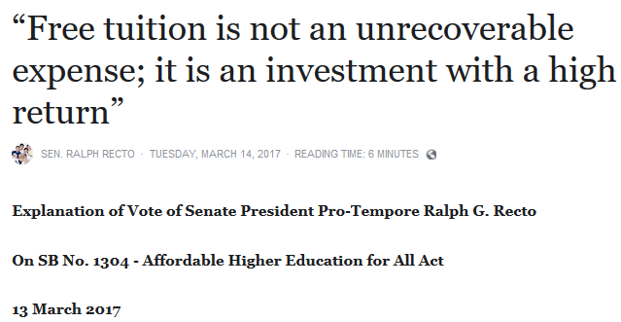

Slide 9


Slide 10


Slide 11
Overview of RA 10931
Also known as the Free Higher Education Act
An act promoting universal access to quality tertiary education by
providing for free tuition and other school fees in state universities and colleges…
establishing the tertiary education subsidy and student loan program,
strengthening the unified student financial assistance system for tertiary education, and
appropriating fund therefor

Slide 12
Free Higher Education in SUCs
Free tuition for all courses/subjects/classes enrolled in during a particular semester/term
Free miscellaneous, other school fees, and similar or related fees, which include fees for the following 13:
library, computer, laboratory, school ID, athletic, admission, development, guidance, handbook, entrance, registration, medical and dental, and cultural

Slide 13
Other fees not covered in Free Higher Education that SUCs collect
All other fees not listed in the law and elaborated in the IRR can be collected by SUCs.
These are specialized fees or course-specific expenses
On-the-job-trainings, Related Learning Experiences for Nursing students, etc.)
Contingent fees (i.e. resulting from negative behavior)

Slide 14
Tertiary Education Subsidy
Supports the cost of tertiary education for the first undergraduate post-secondary program offered in SUC, subject to prioritization and availability of funds
Benefits:
TES 1 – Tuition and other school fees in private HEIs… which shall be equivalent to the tuition and other school fees of the nearest SUCs;
TES 2 – allowances for books, supplies, transportation, and miscellaneous personal expenses, including a reasonable allowance for the documented rental or purchase of personal computer or laptop, an other education-related expenses;
– allowance for room and board costs incurred by the student

Slide 15
TES subsidy amount
As per guidelines set forth by the UniFAST Board
TES 1 – the actual cost of the tuition and other school fees
TES 2 – the normative amount set forth for allowances for
books, supplies, transportation, and miscellaneous personal expenses, including a reasonable allowance for the documented rental or purchase of personal computer or laptop, an other education-related expenses

Slide 16
What is UniFAST
Unified Financial Assistance System for Tertiary Education Act also known as Republic Act No. 10687
UniFAST reconciles, improves, strengthens, expands, and puts under one body all government-funded modalities of Student Financial Assistance Programs (StuFAPs) for tertiary education
scholarships, grants-in-aid, student loans and other specialized forms of StuFAPs
UniFAST board: CHED, TESDA, DOST, DepEd, DOLE, NEDA, NYC

Slide 17
Who are eligible for the program?
Students who are
continuing ESGP-PA scholars in the SUCs effective AY 2018-2019;
part of households included in the Listahanan 2.0, ranked according to the estimated per capita household income; and
not part of the Listahanan 2.0, ranked according to estimated per capita household income based on submitted documentation of proof of income to be determined by the UniFAST Board.

Slide 18
Student Prioritization
Prioritization is given to eligible beneficiaries in the following order:
Students included in the most recently updated Listahanan
Students not in (a) and ranked according to their per capita income based on submitted document(s) of proof of income to be determined by the UniFAST Board

Slide 19
Who are not eligible for the program?
Students who
have already obtained a bachelors’ degree or comparable undergraduate degree from any public or private HEI;
did not qualify under the admission and retention requirements of eligible SUCs
have exceeded the Maximum residency Rule (MRR) of their programs

Slide 20
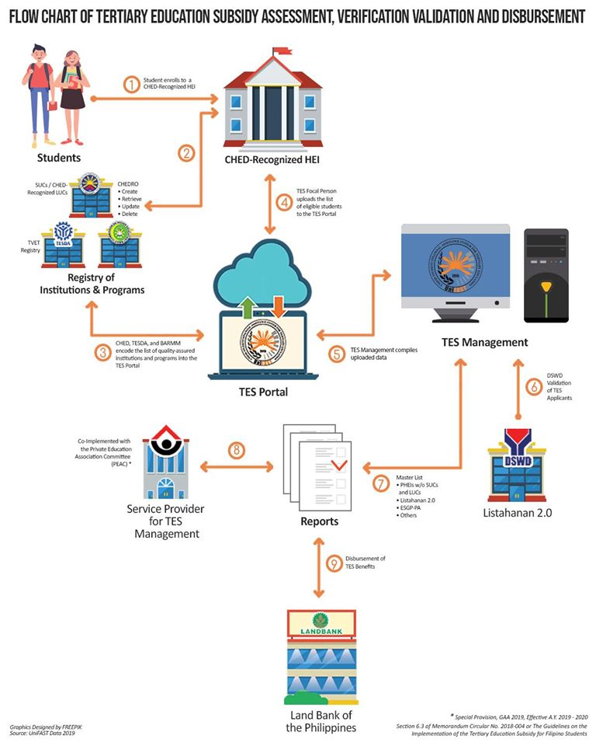

Slide 23
Documentary requirements for TES
Certificate of Residency
Any of the following:
ITR of family members responsible for the financing of your education
BIR 2316
BIR certificate of Exemption from Filing ITR
Brgy. Certification of Indigency or low income
Certification from the DSWD
OFW Certificate
Employment contract of OFW
Other government-issued documents that indicated income

Slide 24
Other Scholarship Programs

Slide 25
Cash Grants to Medical Students (CGMS-SUC) JMC 1 2020, JMC 2018-1 Nov 2018
Intended for all qualified Filipino medical students, both new and continuing, who are enrolled in selected 8 SUCs (MMSU is one); with RSP within the Philippine Health Care System (1:1)
Financial Benefits: Php 37,000.00/AY for tuition fee, book allowance, uniform allowance, experiential learning activities, living allowance
Number of on-going grantees: 28
Contact: COM StuFAPs coordinator, com@mmsu.edu.ph

Slide 26
DOH Pre-Service Scholarship Program
Open to all with priority to those belonging IP and minority sectors, GIDA, low-income families, dependents of government employees and barangay health workers, victims of calamity/tragedy, police/military fatally injures while on duty, to include those who intend to join the program on lateral entry
Financial Benefits: Actual cost of tuition fee, miscellaneous fees, laboratory and student fund incurred in connection with the implementation of the program
Number of on-going grantees: 21
Contact: COM PSSP Coordinator, com@mmsu.edu.ph

Slide 27
PGIN Scholarship for Doctor of Medicine
Open to all qualified residents of Ilocos Norte who will be willing to render return service to increase health practitioners or doctors in the province, with RSP within the province (1:1)
Financial Benefits: Php 104k to Php 131k per AY for matriculation fee, other fees (for 4th year level), and monthly stipend (Php 5k)
Number of on-going grantees: 8
Contact: PGIN Scholarship Coordinator, com@mmsu.edu.ph

Slide 28


Slide 29
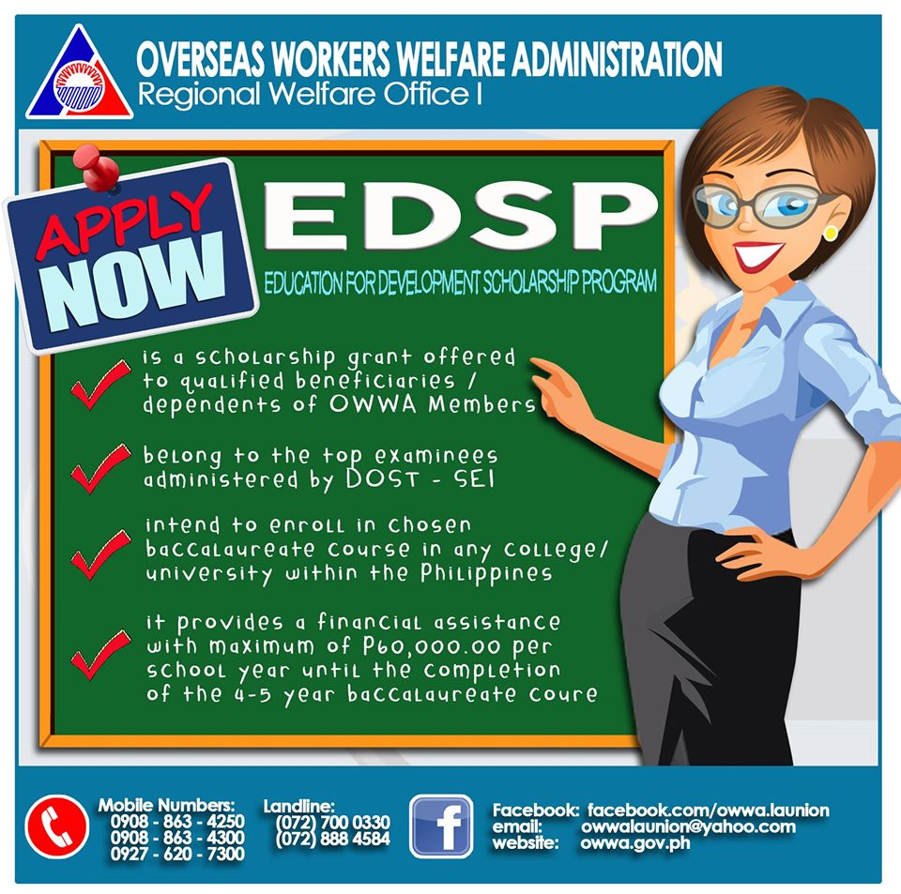

Slide 30


Slide 31


Slide 32


Slide 33
Accommodation and Housing Services

Slide 34
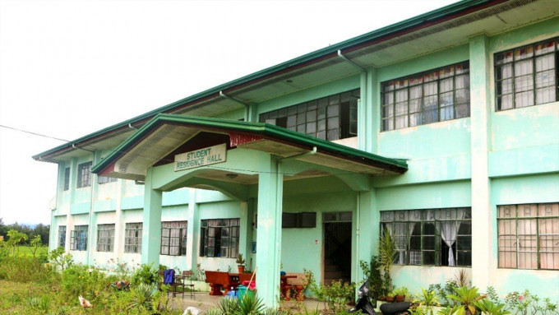

Slide 35
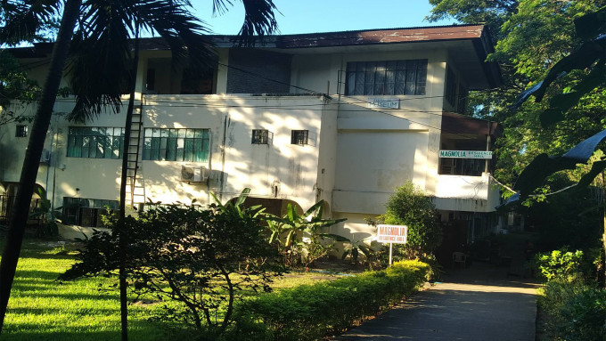

Slide 36
MMSU COEDs Dormitory
Capacity: 320 occupants
6 occupants per room @P200/month rent
(additional charges apply for the use of additional appliances)
____
Apply by accomplishing the Dorm Occupants Registration Form (BD-ACCOM-FRM-011)
Agree by signing a Contract of Lease (COEDs Dorm)

Slide 37
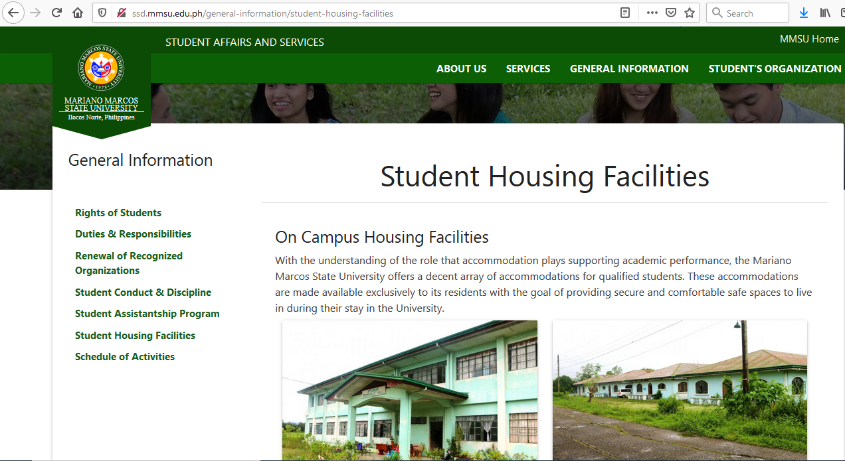

Slide 38
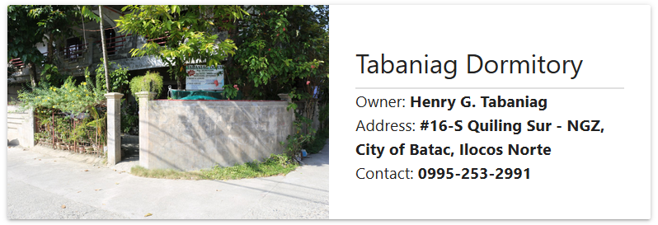
Accredited Off Campus Housing Facilities

Slide 39
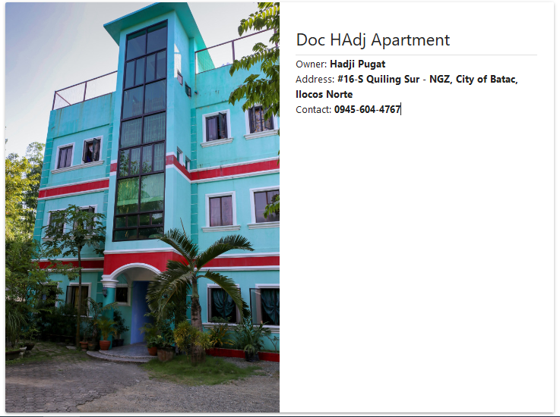
Accredited Off Campus Housing Facilities

Slide 40
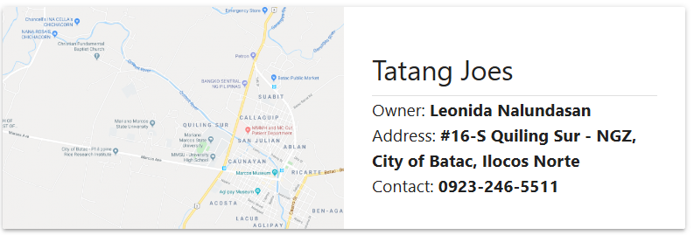
Accredited Off Campus Housing Facilities

Slide 41
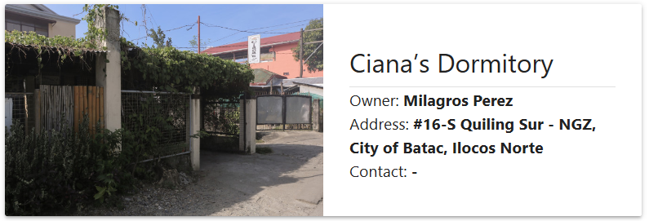
Accredited Off Campus Housing Facilities

Slide 42
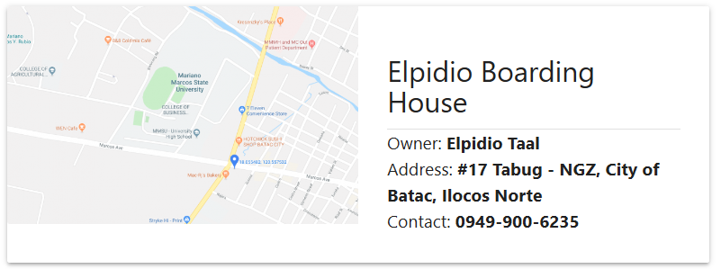
Accredited Off Campus Housing Facilities

Slide 43
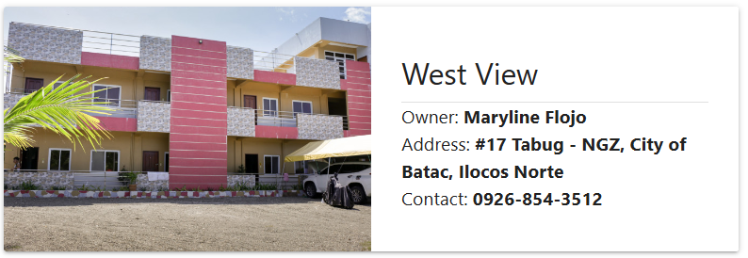
Accredited Off Campus Housing Facilities

Slide 44
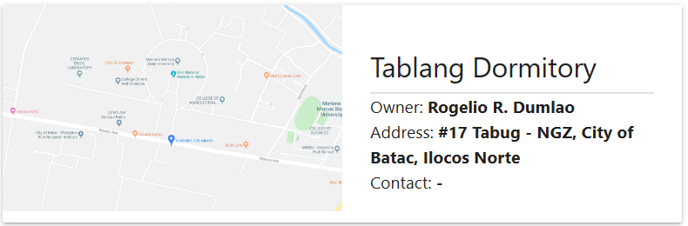
Accredited Off Campus Housing Facilities

Slide 45
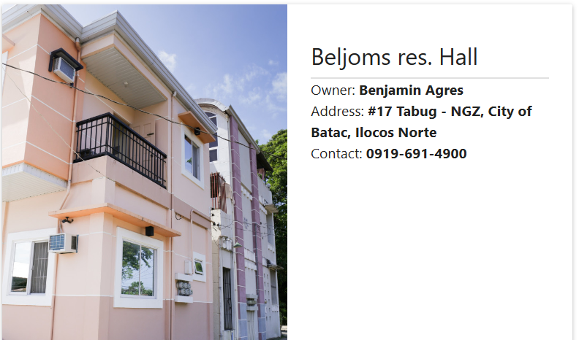
Accredited Off Campus Housing Facilities

Slide 46
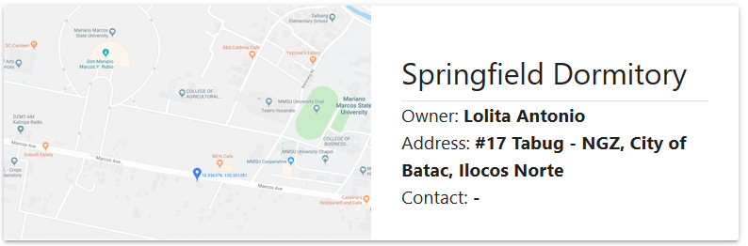
Accredited Off Campus Housing Facilities

Slide 47
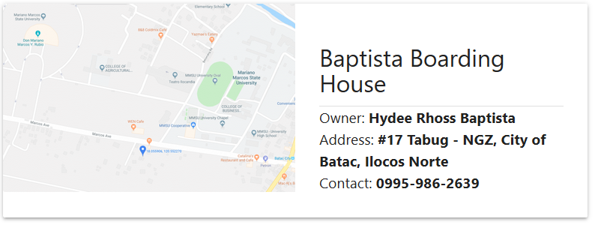
Accredited Off Campus Housing Facilities

Slide 48
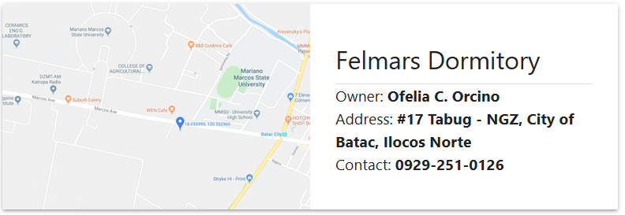
Accredited Off Campus Housing Facilities

Slide 49
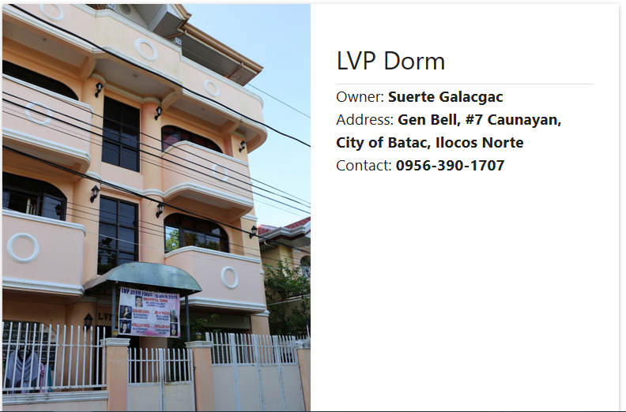
Accredited Off Campus Housing Facilities

Slide 50
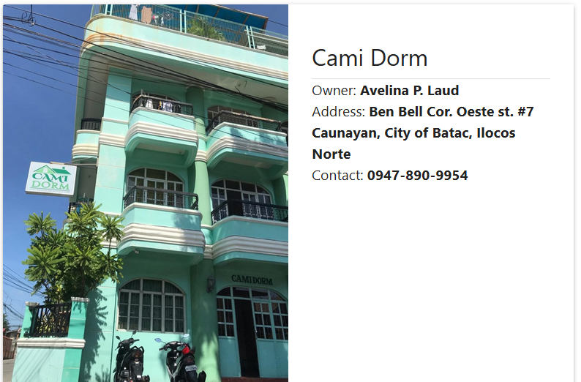
Accredited Off Campus Housing Facilities

Slide 51
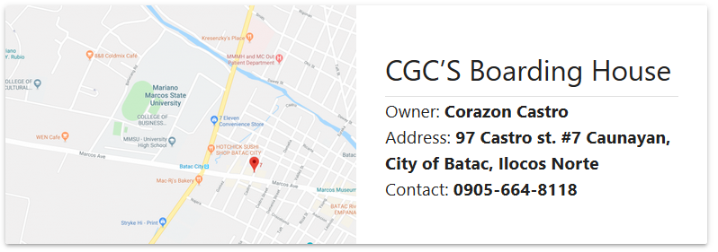
Accredited Off Campus Housing Facilities

Slide 52
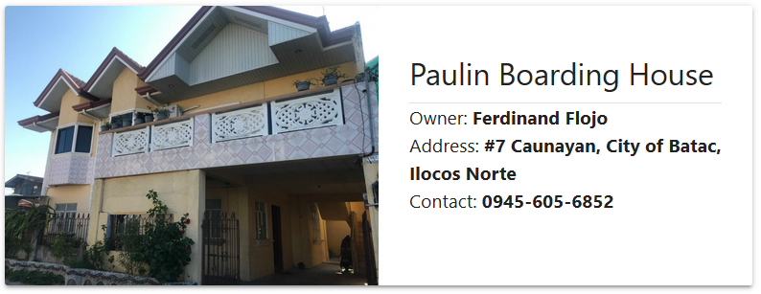
Accredited Off Campus Housing Facilities

Slide 53
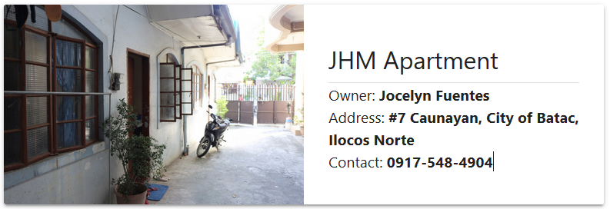
Accredited Off Campus Housing Facilities

Slide 54
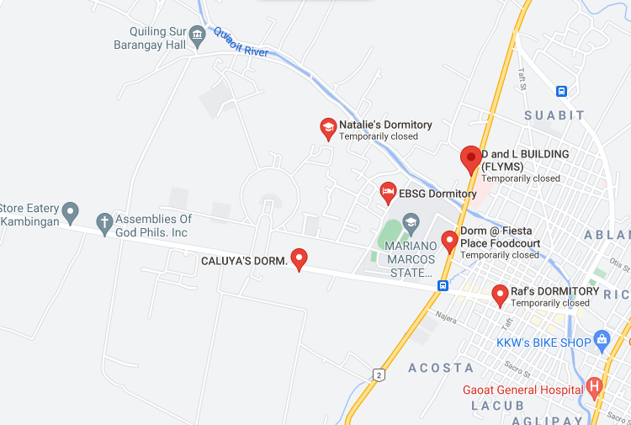
Accredited Off Campus Housing Facilities
Bholsbecs Boarding House
Owner: Teofisto Rangcapan
Address: #16-S Quiling Sur, City of Batac, Ilocos Norte
Contact: 792-3986

Slide 55
Oplan Salinong
Students who were doing their thesis were accommodated at the COEDs Dormitory
to enable them to continually work on their theses within the university premises during the MGCQ
so that they will have an easier access to the university’s stable internet connectivity and to the resources in the University Library System.
Served 23 graduating students (12 males, 11 females)

Slide 56
Innovative Solutions for ISPS Support Services
In support to:
A – Academic Excellence
E – Effective and efficient management
1. Scholar’s Portal
2. Dorm Finder
Computerized and automated technologies to streamline workflows
Efficient and engaging portal system for scholars and dorm seekers
Institutionalized access and information-sharing

Slide 57
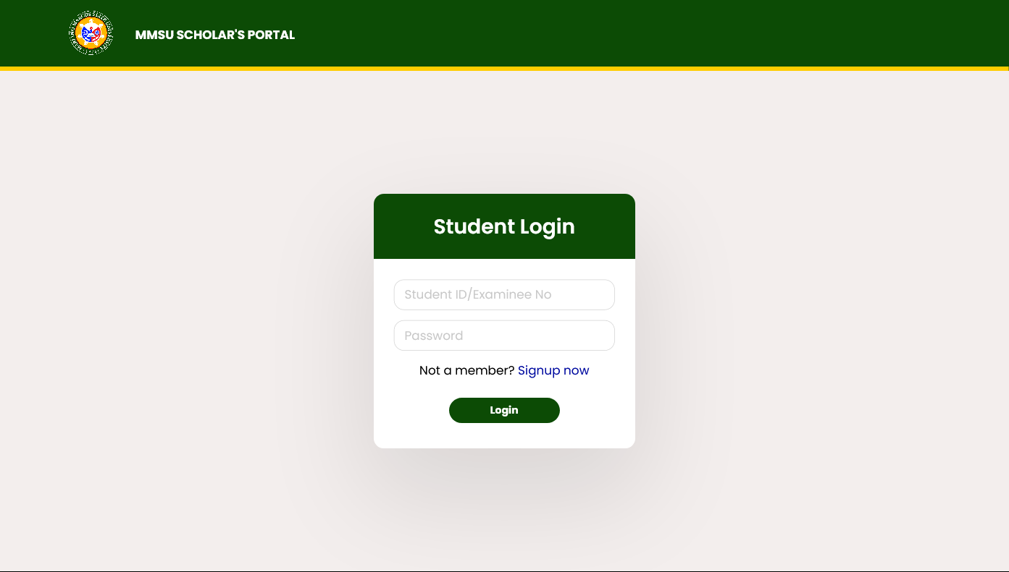
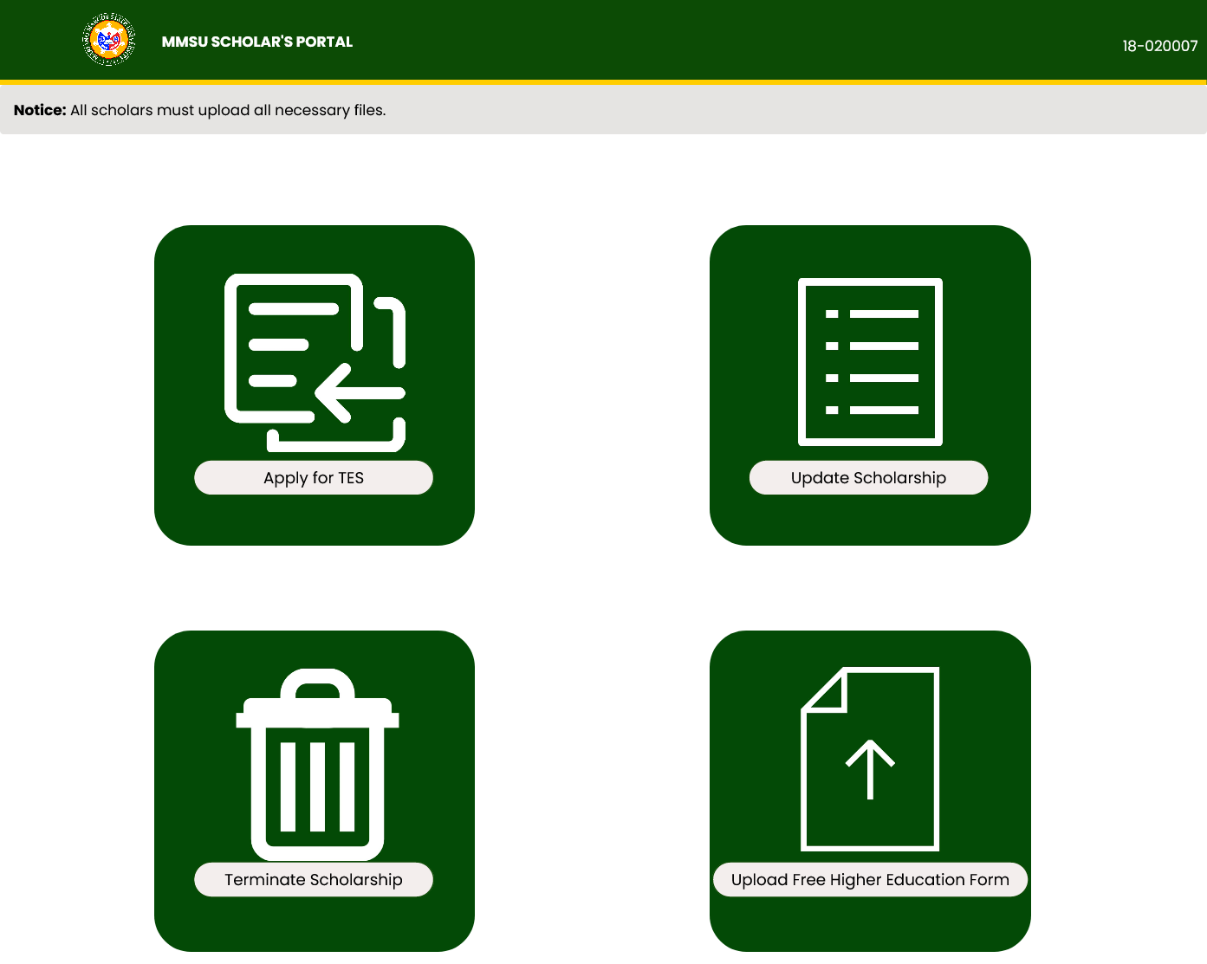
Scholar’s Portal

Slide 58
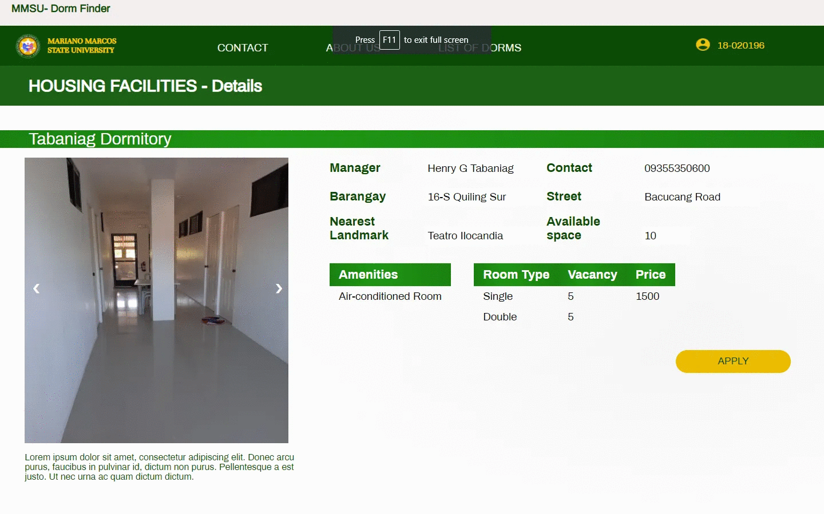
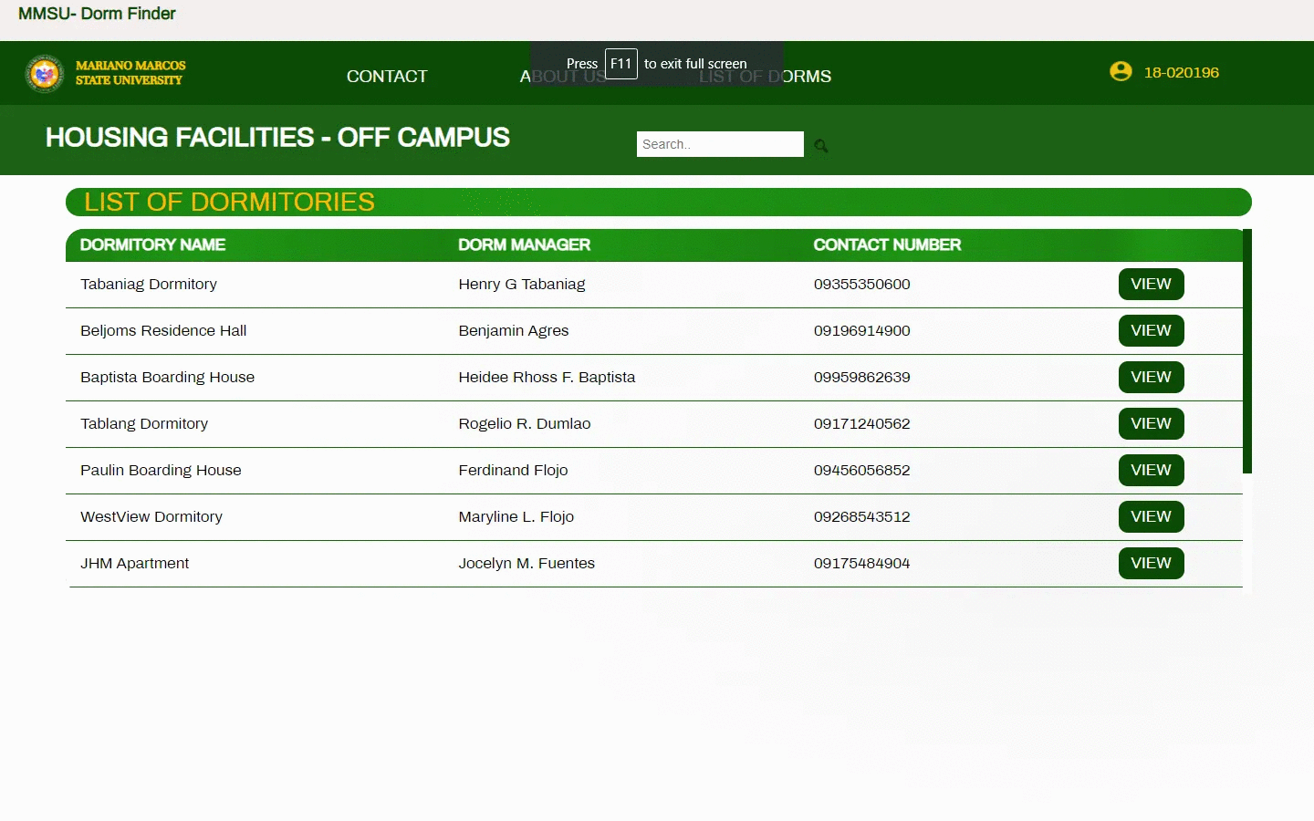
Dorm Finder

Slide 59

Happy to serve.
Thank you!

Slide 60
References
IRR of RA No. 10931
UniFAST web pages available
@https://unifast.gov.ph/tes.php
UniFAST FB page @https://www.facebook.com/unifastofficial/photos/pcb.2401704786583032/2410127292407448/?type=3&theater
CHED Web
@https://ched.gov.ph/what-is-unifast-and-why-was-it-established/
http://ralphrecto.ph/free-tuition-is-not-an-unrecoverable-expense-it-is-an-investment-with-a-high-return/

